Slide 1
Symphony of the Scriptures
Exodus
Notes:
The word Exodus means “exit, departure or going out,” which clearly describes the book’s clear event: the departure of the Hebrews from Egypt to become God’s holy nation (people).
Exodus includes two periods of time: the fourth period - the Egyptian Bondage period and the fifth period of Wilderness Wanderings.
Our study of Exodus begins where Genesis leaves off. Remember that in the last few chapters of Genesis, Joseph, after being sold into slavery, and an amazing chain of events that follow, becomes second in command to the Pharaoh himself. Unaware of his position, his brothers come to Egypt to buy grain during the famine and after revealing his identity and forgiving his brothers, Joseph makes provision for them to come to Egypt where he provides them with land and a livelihood.
And the Hebrews prospered: “All the descendants of Jacob were seventy persons; Joseph was already in Egypt. ⁶ Then Joseph died, and all his brothers and all that generation. ⁷ But the people of Israel were fruitful and increased greatly; they multiplied and grew exceedingly strong, so that the land was filled with them” (Ex. 1:5-7)
Until…. “Now there arose a new king over Egypt, who did not know Joseph. ⁹ And he said to his people, “Behold, the people of Israel are too many and too mighty for us” (Ex. 1:8-9)
The king’s insecurity leads him to Pharaoh who orders the Hebrew midwives to kill every Hebrew male they help deliver.

Slide 2
Exodus
Circa 1525 BC
“Exit” -
“A going out”
“Thus says the LORD: ‘Let My people go, that they may serve Me.’” (8:1)
Bondage
Deliverance
Journey
Law
Tabernacle
Israelites became
numerous
Blood Boils
Frogs Hail
Gnats Locust
Flies Darkness
Livestock Death
Cloud and fire
Moral
Outer Court
150’ X 75’
Red Sea
Social
New Pharaoh
Glory
of the
Lord
Grumbling
Civil
Inner Court
45’ x 15’
Plan to destroy
Israelites
Moses
Passover
Chapters
13-18
Exodus
Chapters
19-24
Chapters
25-40
Chapters 1-2
Chapters 3-12
Place
Egypt
En route
Mount Sinai
Time
430 years (Ex. 12:40)
3 months
1 year
Guidance of
God
Theme
Liberation of people of God
Worship of God
Key Verses
6:6; 12:40-42; 19:5-6
Christ in
Exodus
Passover lamb (ch. 12); sacrificial offering, tabernacle, articles of worship (25-40)
His purity and intercession are pictured in the high priest.
Notes:
Note: Occurrence is around 1250 and covers a span of approximately 360 years from the death of Joseph (Ex. 1:6) to the erecting of the tabernacle in the wilderness of Sinai (Ex. 40:1ff). As we leave Joseph’s story in Genesis we come to Exodus where God’s people are stuck in Egypt. We are introduced to the Book with the “children of Israel” becoming fruitful leading the Pharaoh to protect his own interest by making slaves of them (Ex. 1:7). After this order we find the mother of Moses placing the three-month-old child in a basket where Pharaoh’s daughter rescues him and, with the help of his biological mother, raises him to manhood. Of Moses, Stephen tells us that, “He was learned in all the wisdom of Egypt” (Acts 7:22). The Hebrew writer says he refused the pleasures of Egypt (but could have accepted them - see Heb. 11:25). In his 40th year, after killing and Egyptian (Chapter 2), and fearing for his life, Moses runs away, and he spends 40 years at Midian where he encounters God in the form of a burning bush (Chapter 3). When God asks Moses to lead the people, Moses offers excuses for his limitations and God provides Aaron as his helper. Pharaoh rejects God’s request to “let His people go” and ten plagues are bestowed upon Pharaoh until he finally relents and lets them go (Chapters 3-12). The Passover Feast was celebrated before the coming of the last plague. For 40-years Moses leads his people on a journey (Chapters 13-18) destined for the promise land, through the Red Sea, led by a cloud, fed manna from above, provided clothes that would not wear out; yet they grumbled (complained). It took them only three days to begin complaining (Ex. 11:1-2). The Law (Ten Commandments) is presented on Mt. Sinai (Chapters 19-24) and the people of God reach a covenant with God (24:7). The golden calf incident reflects the fickleness of the Israelites (Ex. 32). The tabernacle is configured and constructed and the method of worship is introduced. Moses lived 120 years and his life consisted of forty years as SOMEBODY, forty years of NOBODY, and the finals forty years as EVERYBODY (the go to man for God): “And there has not arisen a prophet since in Israel like Moses, whom the LORD knew face to face” (Deut. 34:10).
Application:
Lasting freedom comes from God - spiritual freedom is eternal. We are free to follow (or not). We must not make men bigger than God.
When God brings deliverance, He uses choice instruments to do His work (Moses, Aaron, etc.)
Freedom must be balanced with submission to authority from on high.
Key thought: Freedom is not always easy! “Is not this the word that we did tell thee in Egypt, saying, Let us alone, that we may serve the Egyptians? For it had been better for us to serve the Egyptians, than that we should die in the wilderness” (Ex. 14:12, ESV).

Slide 3
Period | History Covered | Scriptures | Years | Principal
Antediluvian | Creation to the Flood | Gen. 1-7 | 1656 | Adam
Postdiluvian | From the flood to call of Abraham | Gen. 8-!1 | 427 | Noah
Patriarchal | From the call of Abraham to Egyptian Bondage | Gen. 12-45 | 215 | Abraham
Egyptian Bondage | From Egyptian Bondage to the Exodus | Gen. 46-Ex. 11 | 215 | Joseph
Wilderness Wanderings | From Exodus to crossing of the Jordan | Ex. 12-Deut. 34 | 40 | Moses
Conquest of Canaan | From crossing of Jordan to Joshua’s death | Josh. 1-24 | 51 | Joshua
Judges | From Joshua to King Saul | Ju, Ruth, 1 Sa. 1-9 | 305 | Samuel
The United Kingdom | From origin of kingdom to its division | 1 Sa. 9-1 Ki. 11; 1 Chr. 10, 2 Chr. 9 | 120 | David
The Divided Kingdom | From the division to the fall of Israel | 1 Ki. 12-2 Ki. 20; 2 Chr. 10-32 | 253 | Elijah
Judah Alone | From fall of Israel to the fall of Judah | 2 Ki. 21-25; 2 Chr. 10-32 | 125 | Josiah
Babylonian Captivity | From the fall of Judah to the return | 2 Ki. 25-8- 21; Dan. 1-6 | 70 | Daniel
Restoration of the Jews | From the return to end of OT history | Ezra, Nehemiah | 92 | Ezra
Between the Testaments | From end of OT to the beginning of the NT | None | 400 | Judas Maccabe
Life of Christ | From birth of Jesus to ascension | Mt-Jhn 21; Acts1 | 34 | Jesus
The Church | From ascension to death of Paul (96 AD approx.) | Acts 2-Revelation | 70 | Paul

Slide 4
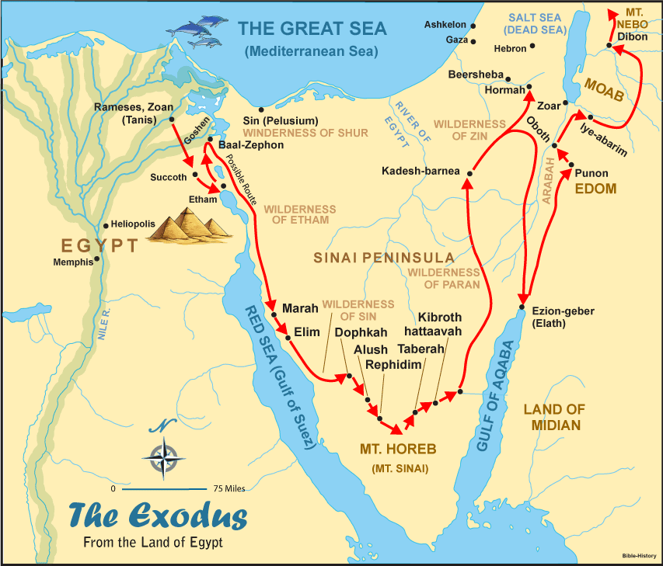

Slide 5
The Pentateuch
Book of the Pentateuch | What it tells us about humanity | What it tells us about God
Genesis | Ruin and rebellion through sin | Sovereignty
Exodus | Redemption from bondage | Omnipotence
Leviticus | Communion and fellowship | Holiness
Numbers | Redirection | Justice
Deuteronomy | Instruction | Faithfulness
Notes:
The first five books of the Bible make up the Pentateuch (from penta, the Greek word for five, and teuchos, which means tool). Otherwise known as the Torah - Each the five books written by Moses.

Slide 6
Introduction
The word Exodus means “exit, departure or going out,” which clearly describes the book’s clear event: the departure of the Hebrews from Egypt to become God’s holy nation (people).
Our study of Exodus begins where Genesis leaves off. Remember that in the last few chapters of Genesis, Joseph, after being sold into slavery, and an amazing chain of events that follow, becomes second in command to the Pharaoh himself. Unaware of his position, his brothers come to Egypt to buy grain during the famine and after revealing his identity and forgiving his brothers, Joseph makes provision for them to come to Egypt where he provides them with land and a livelihood.
And the Hebrews prospered: “All the descendants of Jacob were seventy persons; Joseph was already in Egypt. 6 Then Joseph died, and all his brothers and all that generation. 7 But the people of Israel were fruitful and increased greatly; they multiplied and grew exceedingly strong, so that the land was filled with them” (Ex. 1:5-7)

Slide 7
Until…. “Now there arose a new king over Egypt, who did not know Joseph. 9 And he said to his people, “Behold, the people of Israel are too many and too mighty for us” (Ex. 1:8-9)
The king’s insecurity leads him to order the Hebrew midwives to kill every Hebrew male they help deliver.
"With the death of Joseph, the Genesis record comes to an end. And some 400 years apparently pass before another scriptural account focuses back on the descendants of Israel in Egypt…As the Exodus record begins, a new spiritual leader emerges from among God’s people. For a more sophisticated age, Moses will be a man of education, training, and royal upbringing. He will be an author, lawgiver, builder, and military leader. Most importamtly, he, like Abraham, will be a man of faith in God and an intermediary between God and his people” --- F. LaGard Smith ,The Narrative Bible, page 97
“And there has not arisen a prophet since in Israel like Moses, whom the LORD knew face to face” (Deut. 34:10).

Slide 8
Who wrote the book?
As with Genesis, early Jewish traditions name Moses as the most likely and best qualified person to have authored Exodus. This theory is supported by a number of factors. Moses’s unique education in the royal courts of Egypt certainly provided him the opportunity and ability to pen these works (Acts 7:22). Internal evidence (material found within the text of Exodus itself ) adds support for Moses’s authorship. Many conversations, events, and geographical details could be known only by an eyewitness or participant. For example, the text reads: “Moses then wrote down everything the Lord had said,” (Exodus 24:4 NIV). Additionally, other biblical books refer to “the law of Moses” ( Joshua 1:7; 1 Kings 2:3), indicating that Exodus, which includes rules and regulations, was written by Moses. Jesus Himself introduced a quote from Exodus 20:12 and 21:17 with the words, “For Moses said” (Mark 7:10), confirming His own understanding of the book’s author.
The title “Exodus” comes from the Septuagint, which derived it from the primary event found in the book, the deliverance from slavery and “exodus” or departure of the Israelite nation out of Egypt by the hand of Yahweh, the God of their forefathers.

Slide 9
Where are we?
Exodus begins in the Egyptian region called Goshen. The people then traveled out of Egypt and, it is traditionally believed, moved toward the southern end of the Sinai Peninsula. They camped at Mount Sinai, where Moses received God’s commandments.
The book covers a period of approximately eighty years, from shortly before Moses’s birth (c. 1526 BC) to the events that occurred at Mount Sinai in 1446 BC.

Slide 10
Why is Exodus so important?
First, Exodus reveals the name of God - His nature. Secondly, Exodus demonstrates the faithfulness of God. Third, Exodus pictures the salvation of God. Fourth, Exodus emphasizes the commandments of God. In Exodus we witness God beginning to fulfill His promises to Abraham, Isaac, and Jacob. Though the children of Israel were enslaved in a foreign land, God miraculously and dramatically delivered them to freedom. He then established Israel as a theocratic nation under His covenant with Moses on Mount Sinai. The ten plagues, the Passover, the parting of the Red Sea, the fearsome majesty of God’s presence at Mount Sinai, the giving of the Ten Commandments, the building of the tabernacle . . . these events from Exodus are foundational to the Jewish faith. And they provide crucial background context to help future readers of Scripture understand the entire Bible’s message of redemption. The frequency of references to Exodus by various biblical writers, and even Jesus’s own words, testify to its importance.

Slide 11
What's the point?
The overall theme of Exodus is redemption—how God delivered the Israelites and made them His special people. After He rescued them from slavery, God provided the Law, which gave instructions on how the people could be consecrated or made holy. Holiness matters; it mattered then, and it matters now. God established a system of sacrifice, which guided them in appropriate worship behavior. Just as significantly, God provided detailed directions on the building of His tabernacle, or tent. He intended to live among the Israelites and manifest His shekinah glory (Exodus 40:34–35)—another proof that they were indeed His people. The importance of detail is important. Just as God insisted on specifics regarding the tabernacle, so does it matter how we build our churches. The Mosaic Covenant, unveiled initially through the Decalogue (Ten Commandments), provides the foundation for the beliefs and practices of Judaism, from common eating practices to complex worship regulations. Through the Law, God says that all of life relates to God. Nothing is outside His jurisdiction.

Slide 12
How do I apply this?
Like the Israelites who left Egypt, all believers in Christ are redeemed and consecrated to God. Peter calls us, “a chosen race, a royal priesthood, a holy nation, a people for his own possession” (1 Pe. 2:9-10). Under the Mosaic Covenant, people annually sacrificed unblemished animals according to specific regulations in order to have their sins covered, or borne, by that animal. One’s understanding of the “lamb” in the Old Testament is important to our understanding the “Lamb of God” in the New Testament (John 1:29). One must not miss the implications of blood sacrifice to atone for sin. The author of the New Testament book of Hebrews tells us, “But in these sacrifices there is a reminder of sins every year. 4 For it is impossible for the blood of bulls and goats to take away sins.” (Heb. 10:3–4, ESV). Jesus’s sacrifice on the cross fulfilled the Law. As the perfect Lamb of God, He took away our sin permanently when He sacrificed Himself on our behalf. “And by that will we have been sanctified (holy, NIV) through the offering of the body of Jesus Christ once for all” (10:10, ESV)

Slide 13
Brief Outline
I. The Deliverance of God (1-18)
A. God prepares a deliverer for Israel (1:1-2:25).
B. God sends Moses to deliver Israel out of Egypt (3:1-4:31).
C. Moses’ Initial attempts to deliver Israel fail (5:1-7:13). D. Moses’ continued attempts to deliver Israel fail - plagues (7:14-10:29)
1. Waters Become Blood (7:14-25) 2. Frogs (8:1-15) 3. Lice (8:16-19)
4. Swarms of flies (8:20-32)
5. Pestilence (9:1-7)
6. Boils (9:8-12) 7. Hail (9:13-35) 8. Locusts (10:1-20) 9. Darkness (10:21-29).
E. Moses’ Final Attempt To Deliver Israel Succeeds (11:1-12:51).
1. Moses announces the final plague (11:1-10).
2. God gives Israel the Passover (12:1-28).
3. God strikes the firstborn in Egypt (12:29-30).
4. Moses leads Israel out of Egypt (12:31-51).

Slide 14
F. Israel’s Journey To The Red Sea (13:1-15:21) 1. They are commanded to consecrate their firstborn (13:1-16).
2. God leads them in a pillar of cloud and fire (13:17-22).
3. God saves them from the Egyptians (14:1-31).
4. They sing a song of victory to the Lord (15:1-21). G. Israel’s Journey On To Sinai (15:22-18:27) 1. They repeatedly complain against Moses (15:22-17:7).
2. Joshua leads them in war against Amalek (17:8-16).
3. They are joined by Moses’ father-in-law, wife and sons (18:1-12).
4. Moses appoints rulers to help him judge them (18:13-27).
II. The Covenant of God (19-24)
A. God makes a covenant with Israel - the Ten Commandments (19:1-20:21).
B. God reveals His covenant through Moses (20:22-24:18).
II. The Tabernacle of God (25-40)
A. God Tells Israel To Make Him A Sanctuary – Furnishings(25:1-27:21).
1. An Ark & A Mercy Seat (vv. 10-22)
2. A Table (vv. 23-30) 3. A Lampstand (vv. 31-40)
4. The Curtains & Coverings (26:1-14)
5. The Frame (26:15-30)
6. The Veil (26:31-35)
7. The Door (26:36-37)
8. The Altar Of Burnt Offering (27:1-8)
9. The Court (27:9-19) B. God gives instructions for the consecration of the priests (28:1-29:46)

Slide 15
D. God gives final instructions for the tabernacle (30:1-31:18).
E. Israel’s worship of the golden calf (32:1-35). F. God’s broken relationship with Israel is restored - Moses’ face shone (33:1- 34:35). G. The Tabernacle Of God Is Completed (35:1-40:38)
1. An offering was taken, and artisans were called to build the tabernacle (35:1-36:7).
2. The work was done, and the tabernacle was erected (36:8-40:33).
3. The glory of God filled the tabernacle (40:34-38).

